Slide 1
Company insights
Part 1: web scraping
Date – 11/28/2022

Slide 2
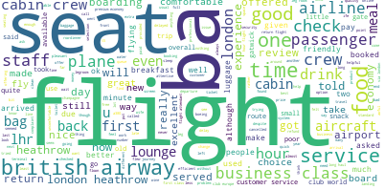
Topic modeling
Some of the frequent words from the reviews are seat, flight, food and cabin crew

Slide 3
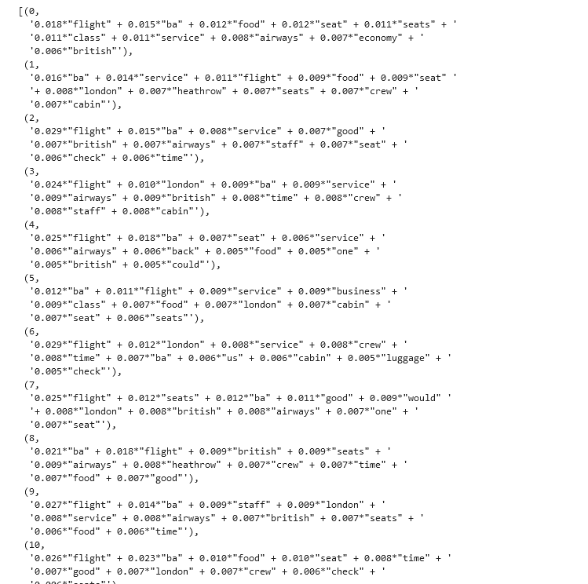
Snippet of the top 10 topics from the model

Slide 4
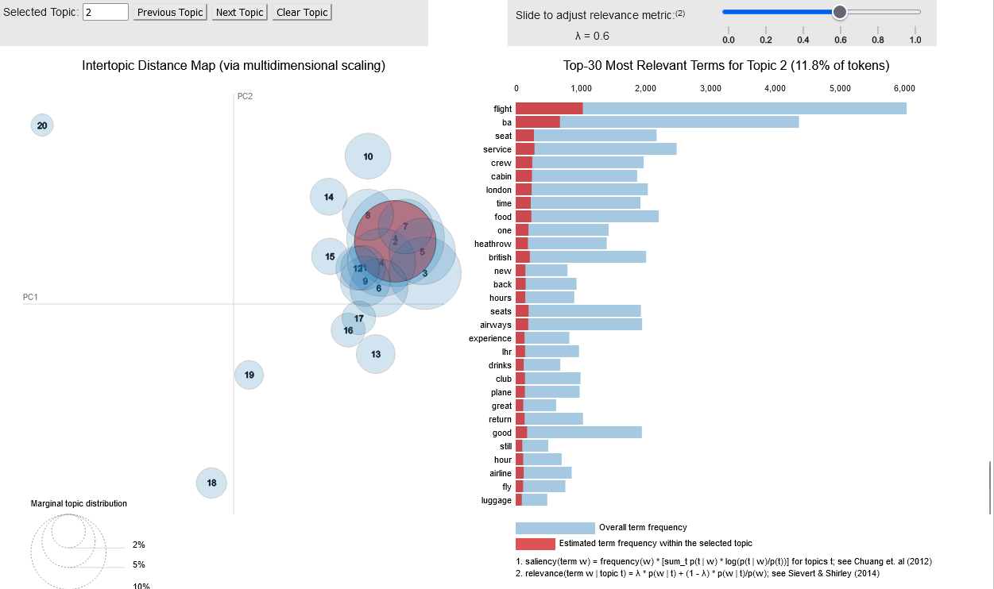
Visualization on the topics

